Slide 1
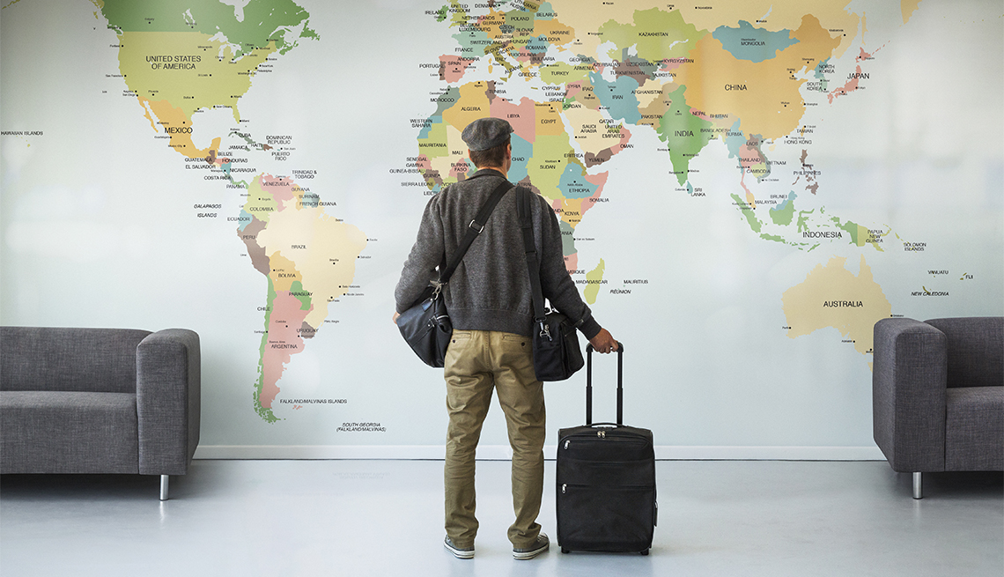
Where a new user will book the first travel experience ?

Slide 2

Problem Definition
New users on Airbnb can book a place
to stay in 34,000+ cities across 190+ countries.
By accurately predicting where a new user will
book their first travel experience.
There are 12 possible outcomes of the destination country: 'US', 'FR', 'CA', 'GB', 'ES', 'IT', 'PT', 'NL','DE', 'AU', 'NDF'

Slide 3
Analysis & Modeling Airbnb New User Bookings

Slide 4
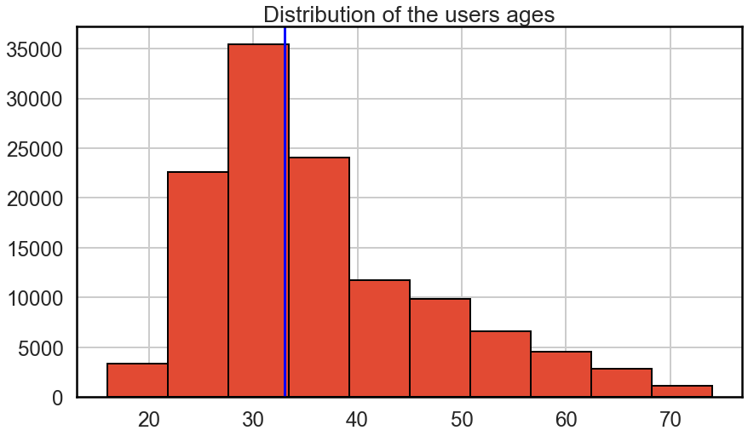
User segments & the paid marketing
the age group from 15 to 39 is the most user segment.

Slide 5
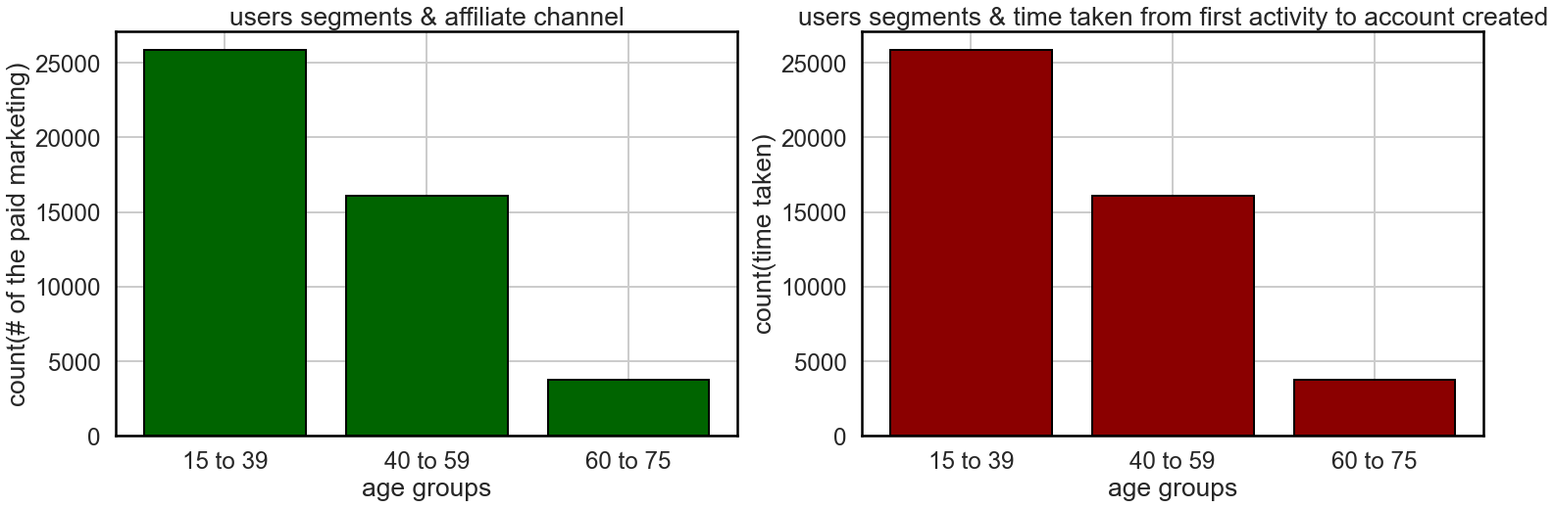
User segments & the paid marketing
Most paid marketing forward to the age segment from 15 to 39
Most age group take time from first activity to account created is from 15 to 39

Slide 6
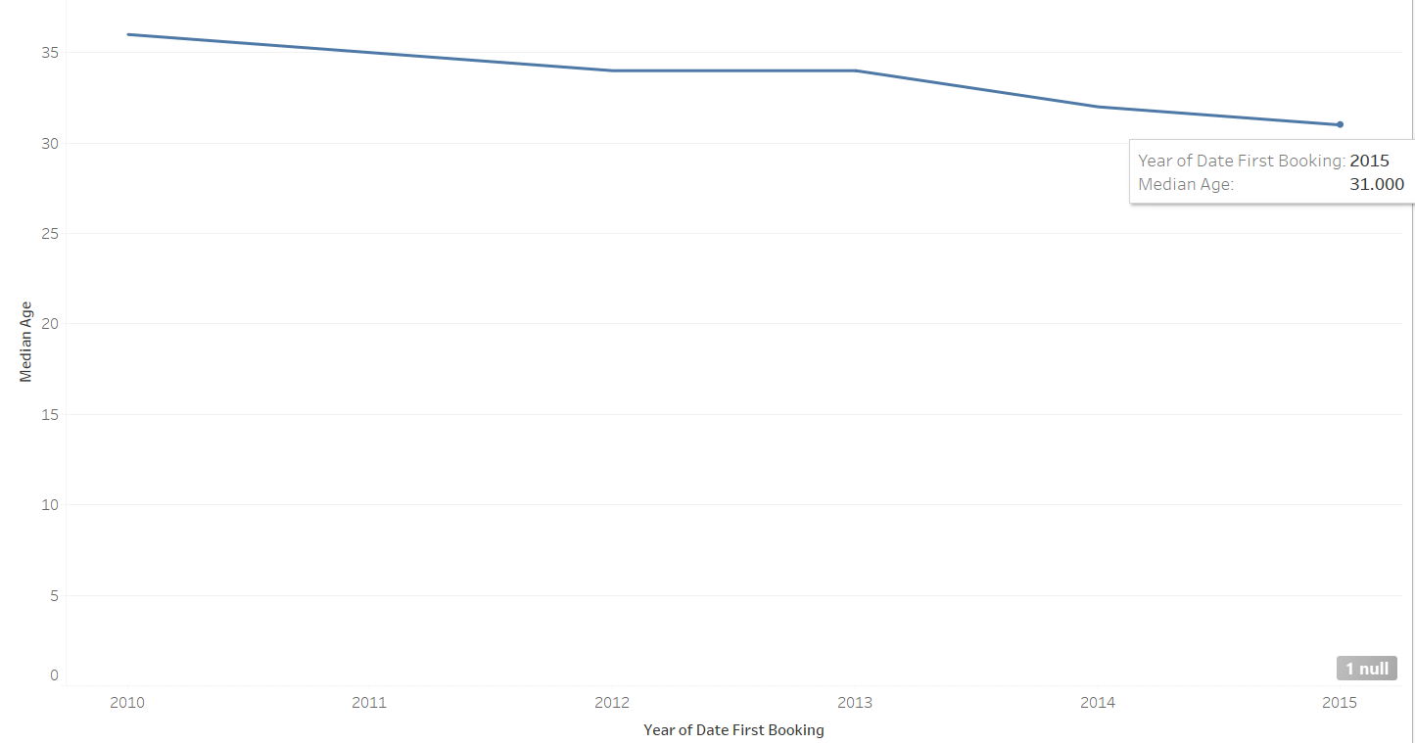
Decreasing in users median age
the time taken from first activity to first account created in the age group 15 to 39 is highest time taken.
Despite the advertisings providers more likely to target the age group from 15 to 40.
which lead us to fetch for bugs in the paid marketing plan or strategy to decrease the gap time.
How ever most age group using Airbnb from 15 to 40 and the number of age group users is increasing by the time.

Slide 7
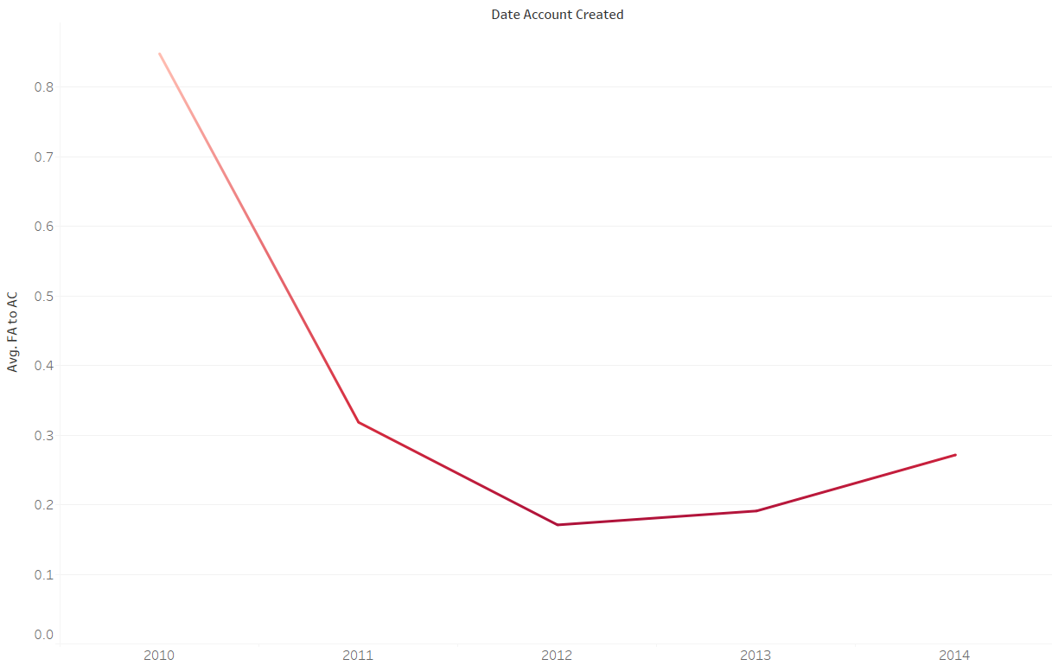
Decrease in the time taken from first activity to account created
Users take less time from their first visit until create the Airbnb account from 2011 to 2012 which is good indicator.
53.7%

Slide 8
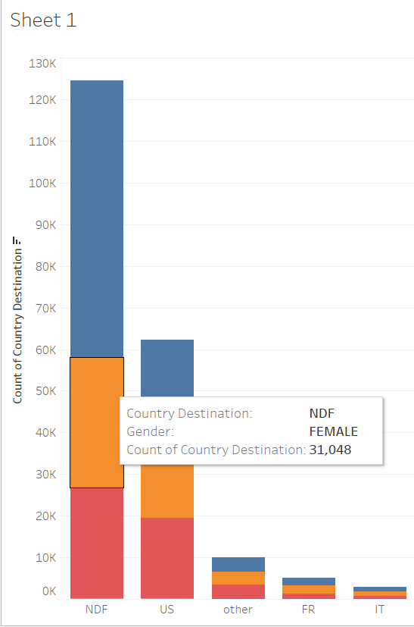
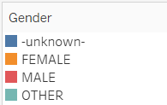
Females have high possibility to NDF more than Males
Decision Recommendation
Marketing campaign tends to increase the sense of safety & more security trips specially for females to decrease the founded gap.
Benefits
System credibility for most of the users not just females, hence more new user booking.

Slide 9
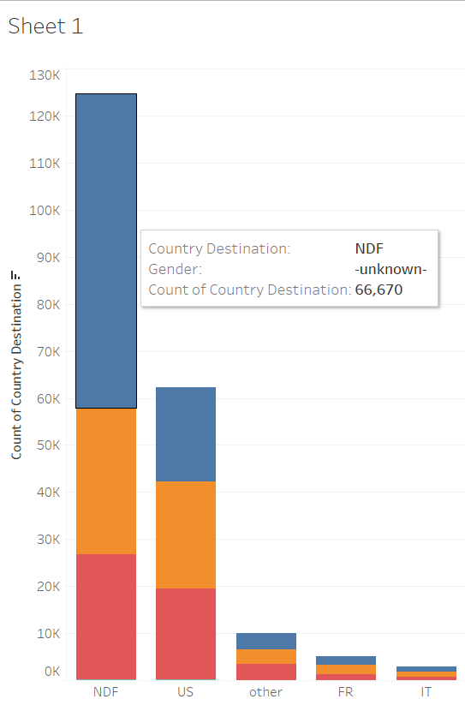
More “unknown” gender, more NDF “no destination found”
The user who didn’t identify his gender tends to more system exploration rather than choose destination & they maybe just scrolling and discovering the application of Airbnb.
Add more information, images and explanation for the users to support his/her action.

Slide 10
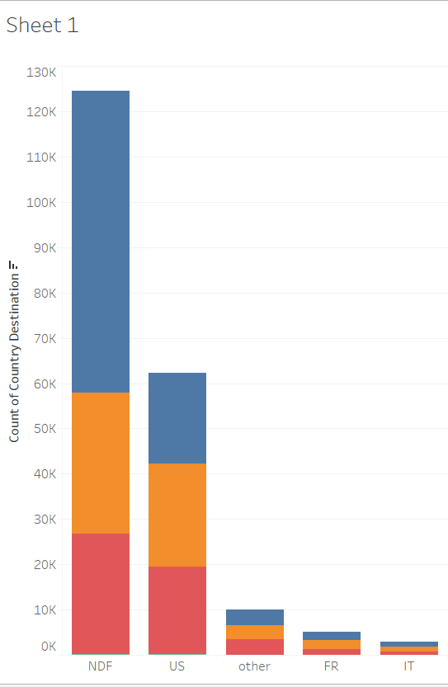
Most first users destination is to USA hence users prefers their first trip to be inside the country
USA 29.2 % of all first destinations.

Slide 11
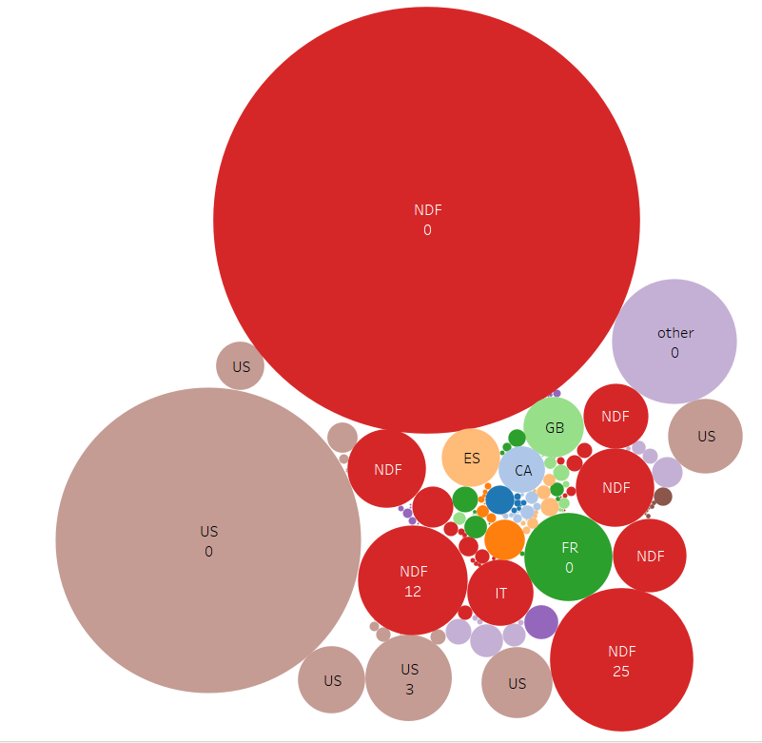
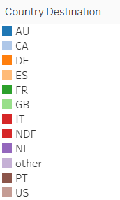
Sign up flow and user country destination
page 25,24,23,12 have high possibility that the user will not choose a destination (enhance the pages performance)
page 0 has high possibility that the user will choose a destination but although has higher possibility the user will not choose a destination so it needs to be more dynamic, user experience and fix it's pugs if found

Slide 12
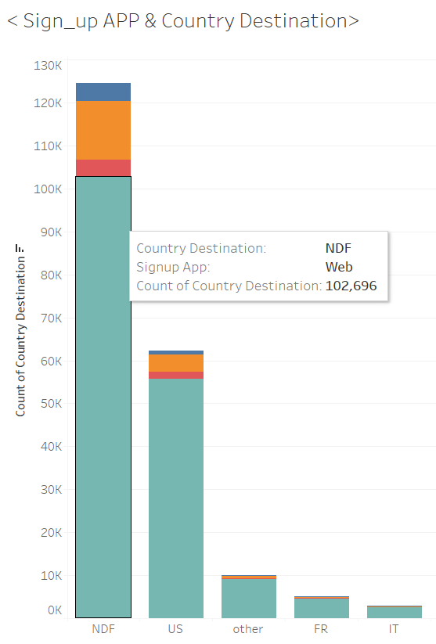
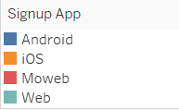
Signup using web app have high possibility to NDF
Decision Recommendation
Enhance and develop more and more on user interface & user experience.
Benefits
More comfortable displaying app options leads to more user engagement to the system.

Slide 13
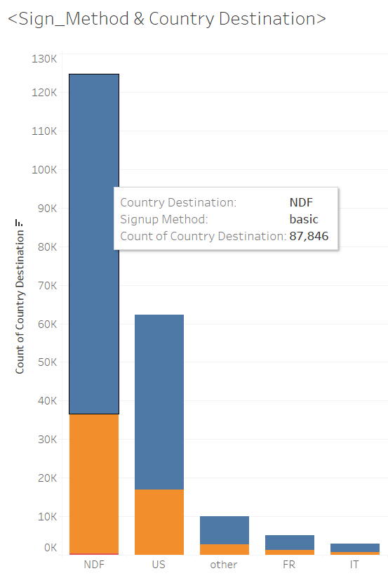
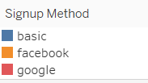
Signup method basic have high possibility to used
most users use their basic account to signup which means maybe they are afraid from exchanging their other info in other platforms like facebook and google with airbnb (A feeling of insecurity).

Slide 14
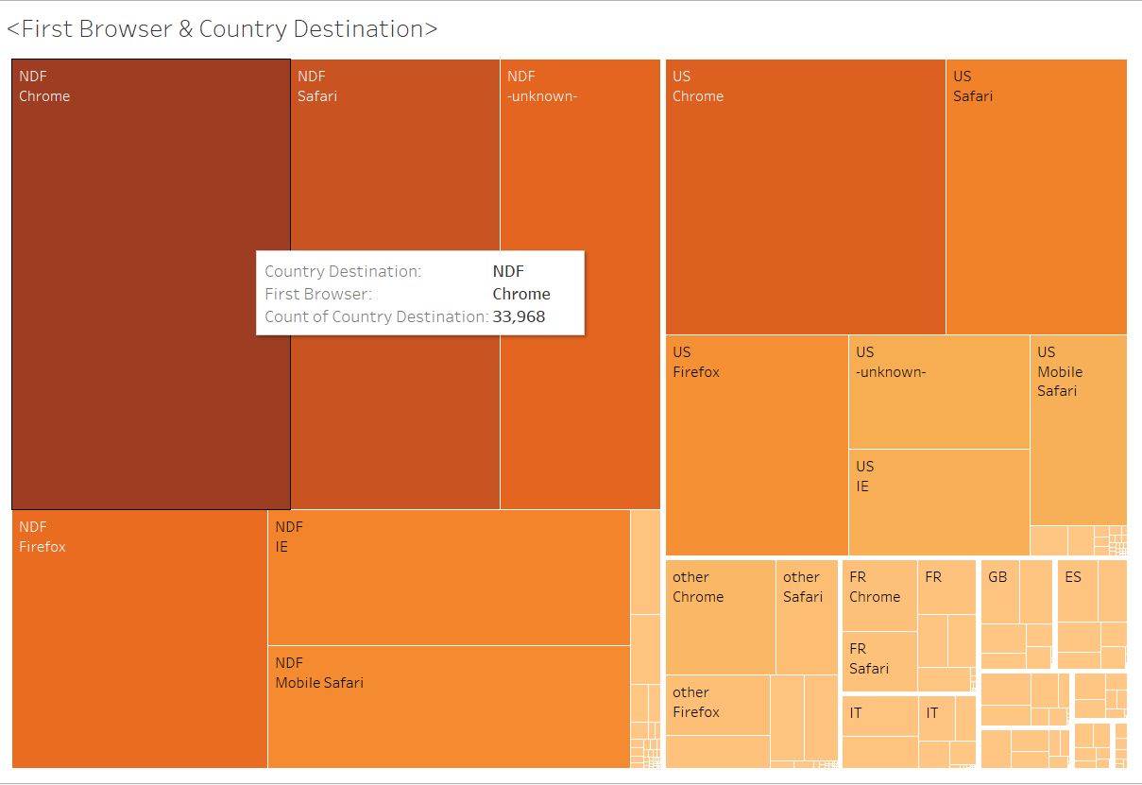
chrome users are more likely to use the airbnb, so maybe it's preferred from the business side to cooperate with google to enhance google chrome users experience.

Slide 15
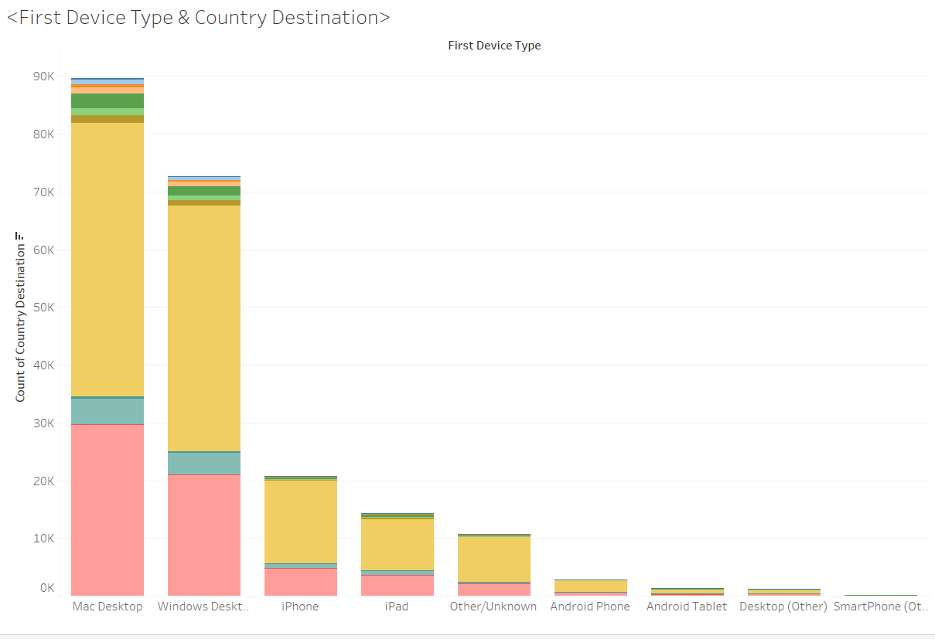
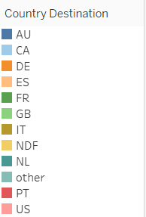
Desktop Users either mac desktop or windows desktop book far more often than other device users. This could mean that people use smaller devices for surfing and exploration and desktops to make the actual booking.
The User Experience for the apps on different devices must be tuned accordingly to achieve best results.

Slide 16
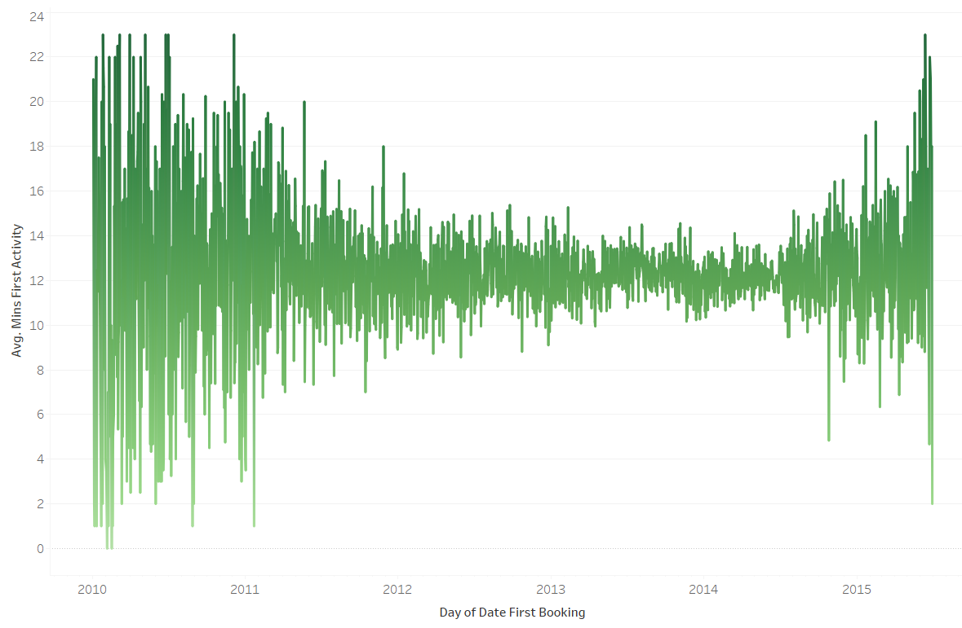
Increase on the first activity minutes from 2014 to 2015
26.3%

Slide 17
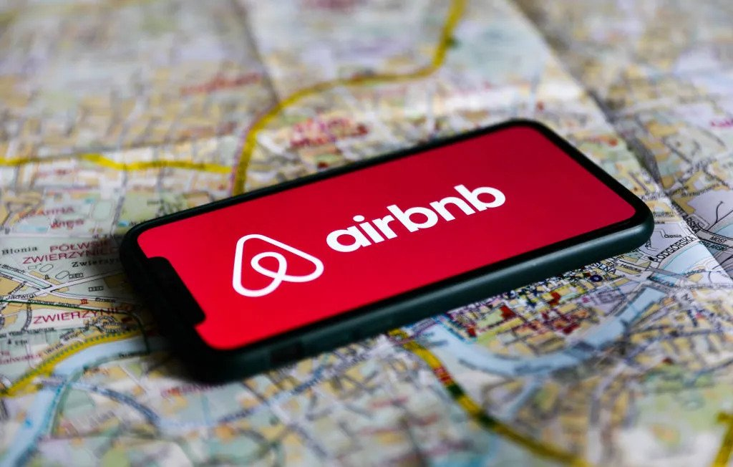
Thank you

